Slide 1
Centralize SSIS
Store all SSIS projects on one SQL Server
Presenter: Michellea David
Email: SQLMichelleaDavid@gmail.com
Slides at Github: https://github.com/SQLGrillen/NSOD-1

Slide 2

About me: Michellea David
20 years experience in Oracle, SQL Server
Solaris certified
Worked for companies like Sun Microsystems (now Oracle), Los Alamos National Laboratory, Carlson Wagonlit Travel Corporation, and Mechanics Bank
Hobbies include: Traveling, theatre, learning about different cultures, and food
Looking for a job if anyone knows of a Sr/Lead/or Manager DBA position available.
Email: SQLMichelleaDavid@gmail.com

Slide 3
What we will discuss today:
What is a Centralized SSIS Environment
Reasons to use a Centralized Environment
Pros and Cons for a Centralized Environment
How to create a Centralized SSIS Environment
Permission issues
Which server CPU and Memory is being used
Where will job execution information be stored

Slide 4
What is a Centralized SSIS Environment?
A Centralized Environment is an environment in one location.
Picture all you jobs and SSIS code, for all the servers and databases you monitor, in one location.
All the job history, for every job you monitor, on one server.

Slide 5
Reasons to use a Centralized SSIS Environment
Tired of going to each SQL Server’s job history to find out if any jobs failed?
Only review one server daily
Run all jobs from one server
Have one centralized SSIS repository
Pull all log data into one centralized database
Tired of loading the SSIS package on Development, QA, and then Production?
Run the same code for Prod, QA, and Dev with different variables.

Slide 6
Advantages
Central Management location
Easily Scale packages by adding memory to the central server
Keep the ETL workload away from the other databases
Standardize and control multiple SQL instances from one SSIS package
Disadvantages
Must license the SQL Server
Remote data must be copied over the network before entering the data flow buffer.

Slide 7
How to Create and store Centralized SSIS code?
Pick a server to create the SSIS Catalog and set up the catalog
Create the package with project variables
Deploy the package to the SSIS Catalog
Set up Environment variables for each Server/Environment
Link the environment variables
Create a job running the SSIS Package
In the job, set the environment you would like the job to run on

Slide 8
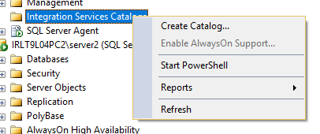
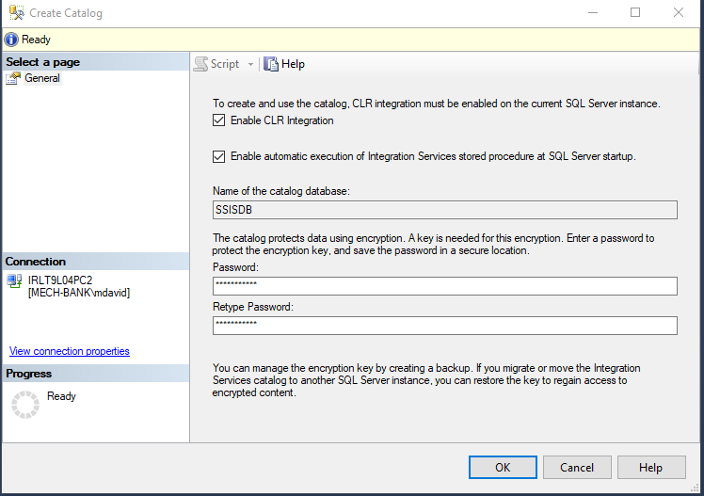
Step 1: create an SSIS Catalog
On the SQL Server in Integration Services Catalogs.
Create the catalog by right clicking on the Integration Services Catalog/Create catalog.

Slide 9
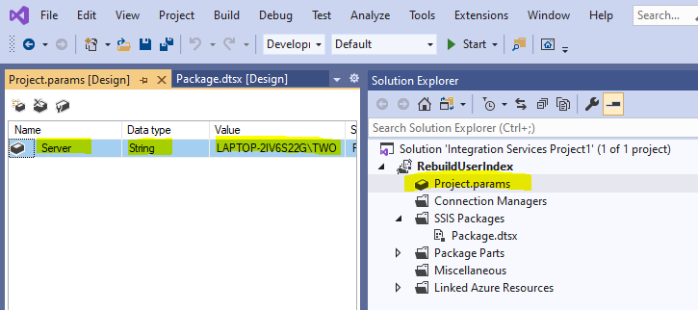
Step 2: create an SSIS Package with Project Variables
Open Visual Studio, create a new SSIS project
Double-click Project.params to open and add a Server variable
Create a Control Flow Task with a connection
Go to Connection properties and create an Environment variable for ServerName. Link the variable to the project variable. (next slide)

Slide 10
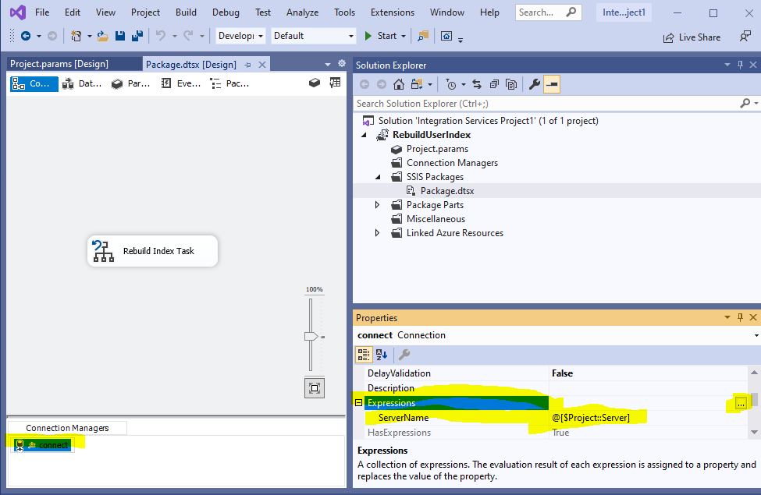

Slide 11
Demo
In this demo, I will show an SSIS package with a connection function using project variables. Visual Studio 2019

Slide 12
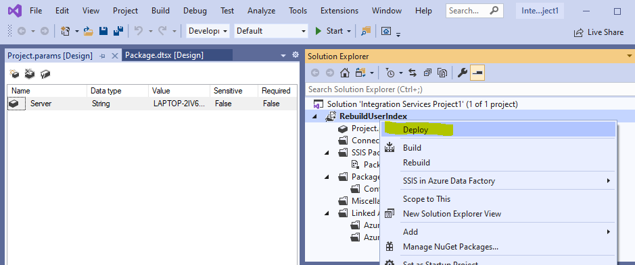
Step 3: Deploy the SSIS Package in to the SSIS Catalog

Slide 13
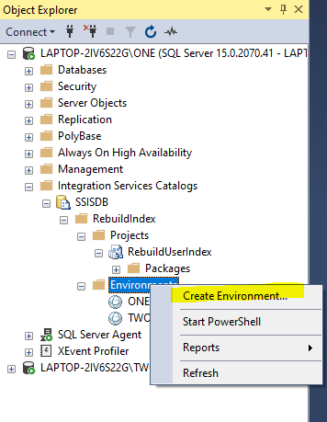
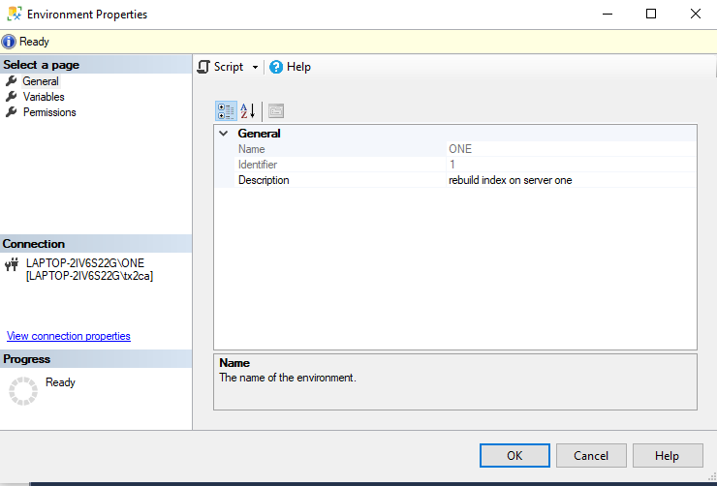
Step 4: Set up Environment Variables in SSIS Catalog

Slide 14
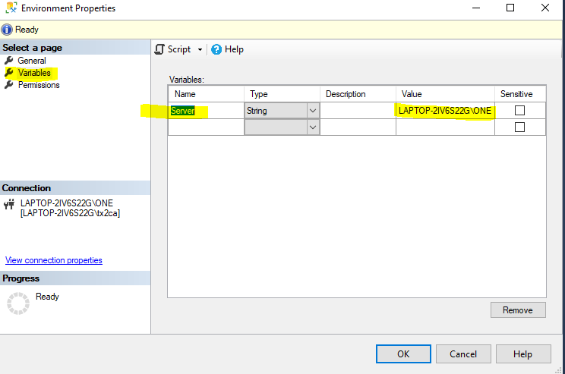
Name the variable in the environment properties and give the variable a value.
In order to name the variable, go to the package variables and find the project variable name.
(Next Slide)

Slide 15
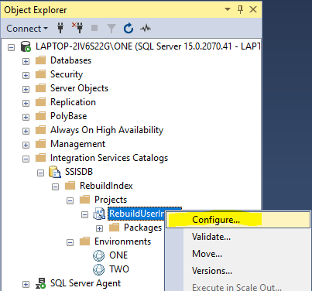
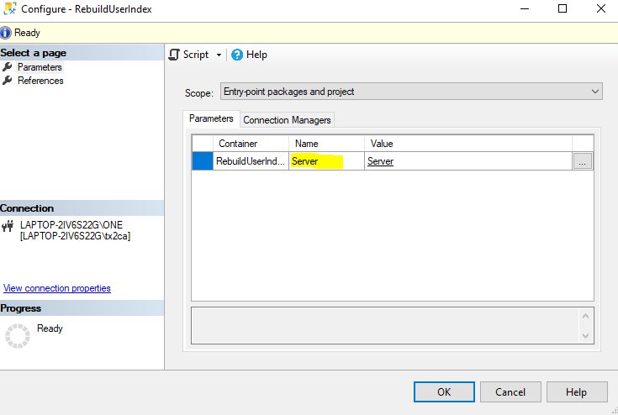
Find the project variable Name in order to name the environment variable

Slide 16
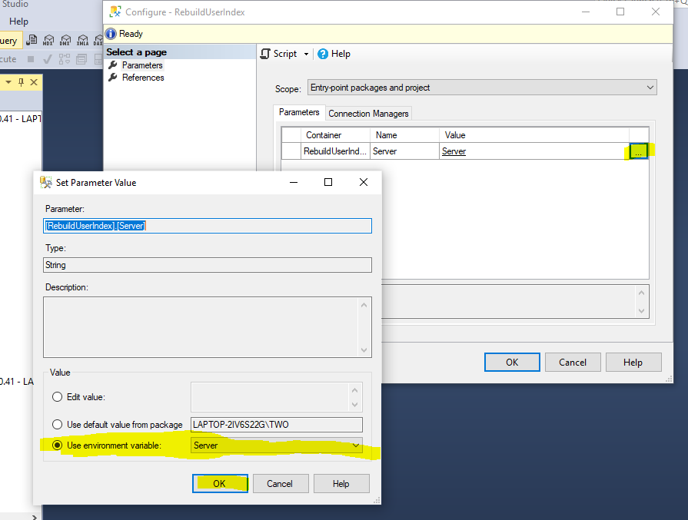
Link the Variable(S)
While in the Package Configuration Parameters page, select the three dots next to the parameter.
In the next window, select “Use Environment variable” and select the variable name.

Slide 17
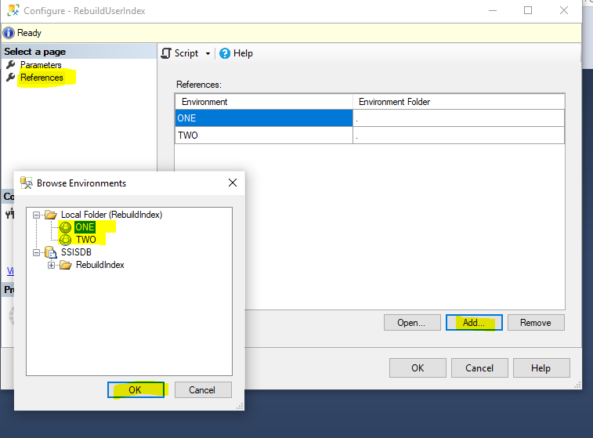
Link the Environments
While in the package configuration, go to references page.
Add all environments to the references list.

Slide 18
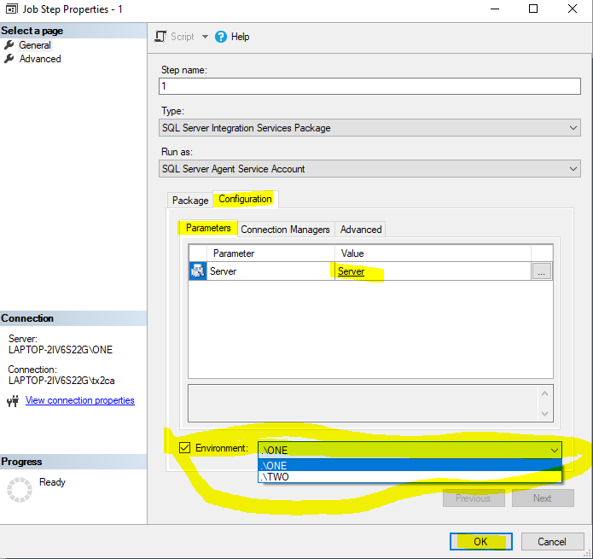
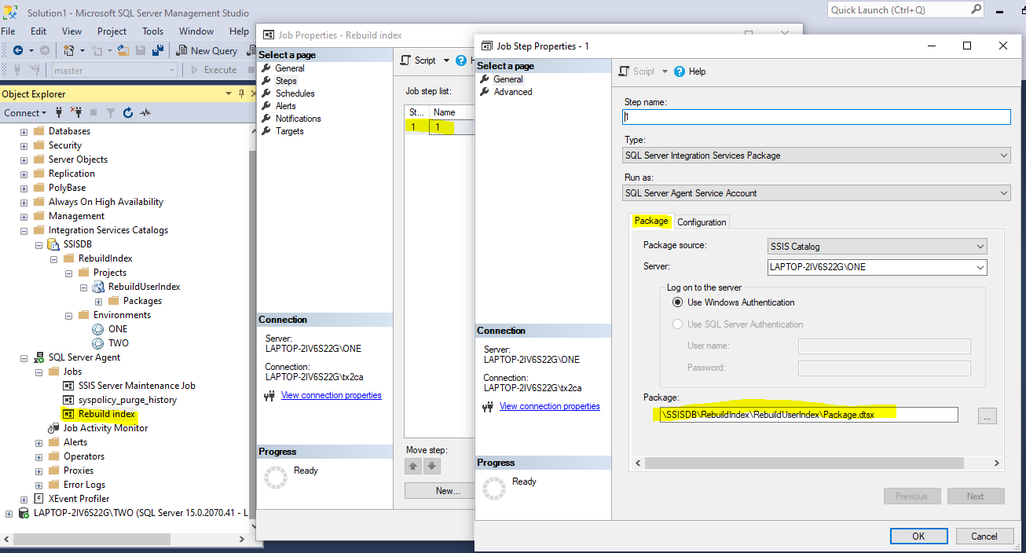
Create the Job and link the environment to use
Create a step using the SSIS Package.
Go to the Configuration tab and set the Environment

Slide 19
Demo
In this demo, we will run the same SSIS in two separate databases, without changing the SSIS code.

Slide 20
Permissions between servers
The Service Account running the SQL Agent must have permissions on the target server to execute what the SSIS code wants to execute.
TIP: Run the Master SQL Server/SQL Agent and all target SQL Servers/SQL Agents under the same Service Account.

Slide 21
Where does SSIS use resources (Memory or CPU)? It Depends
Job A created on Server A but points to Server B to pull data
Job A is kicked off on Server A using Server A resources
The select statement runs on Server B using Server B resources
The data pulls across the network back to Server A for further analysis or transformation, using Server A resources.
Job A on Server A but point to Server B to run Backup
Job A will kick off on Server A using Server A resources
However the backup will occur on Server B using Server B resources

Slide 22
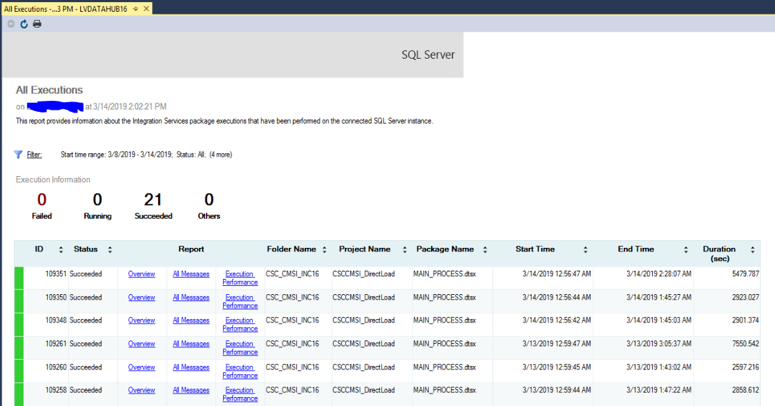
Where will the job execution information be stored?
On the Centralized server with the stored SSIS code.
In order to review the execution, right click on the project, select reports/Standard Reports/All Executions

Slide 23
Next Step Suggestions:
Create a database on the centralized SSIS server to store all the job data into one table.
Create procedures to store data in one table OnError, OnInformation, OnPostExecute, OnPreExecute, and OnWarning. Call the each procedure in the main package of your SSIS.

Slide 24
Next Step: Create Process Control Log
Create a ProcessControl Database
Create the ProcessControlLog table
Create a Procedure to delete data from the ProcessControlLog table daily. Keep Statistics for at least one month.
Create Procedures for OnError, OnPreExecute, OnPostExecute, OnWarning, etc..
Call Procedures from the main SSIS package EventHandler

Slide 25
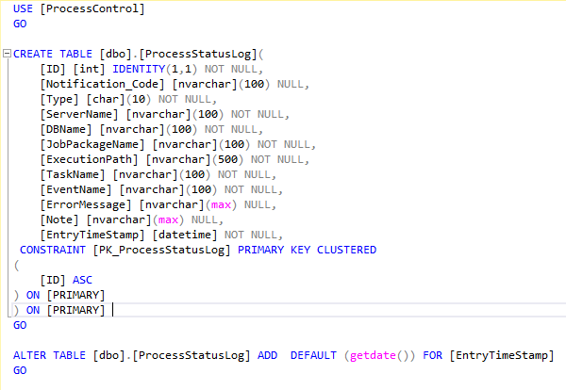
Create Log Table

Slide 26
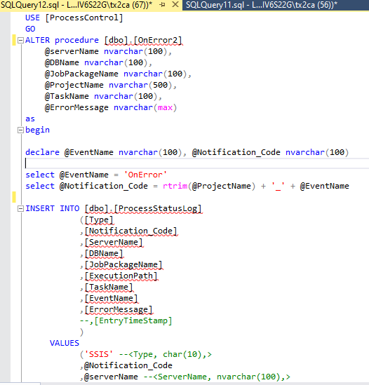
Create Procedures
See Code in gethub

Slide 27
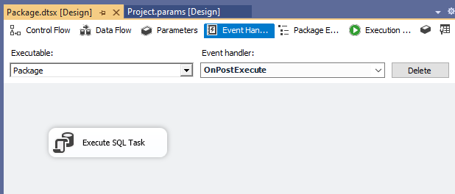
Create EventHandler in Main Package
Configure the Each event handler to execute a SQL Task from the centralized log database you created. The SQL Task will be a procedure stored in that database.
OnError – exec [dbo].[OnError2] ?, ?, ?, ?, ?, ?
OnInformation - exec [dbo].[OnInformation2] ?, ?, ?, ?, ?, ?
OnPostExecute - exec [dbo].[OnPostExec2] ?, ?, ?, ?, ?, ?
OnPreExecute - exec [dbo].[OnPreExec2] ?, ?, ?, ?, ?, ?
OnWarning - exec [dbo].[OnInformation2] ?, ?, ?, ?, ?, ?

Slide 28
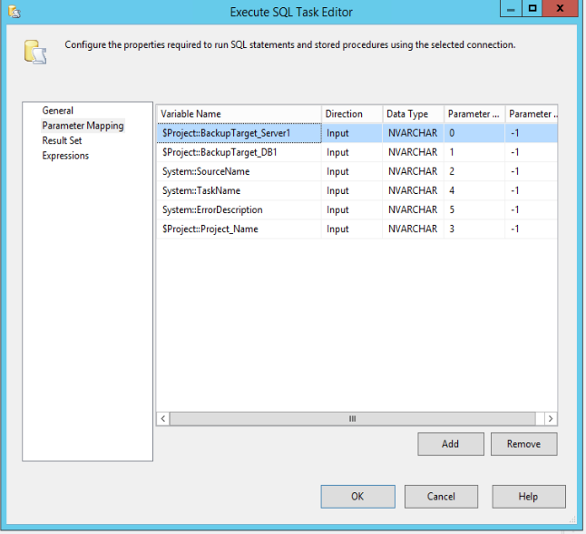
Example of the Parameter mapping for OnError Execute SQL Task

Slide 29
Demo
In this demo, I will show the contents of the ProcessControlLog table from running the job for each server. We will also review the EventHandler in SSIS.

Slide 30
References
Tim Mitchell - Creating the SSIS Catalog
https://www.timmitchell.net/post/2017/07/03/creating-the-ssis-catalog/
Melissa Coates – Parameterizing Connections and Values at Runtime Using SSIS Environment Variables
https://www.sqlchick.com/entries/2015/1/4/parameterizing-connections-and-values-at-runtime-using-ssis-environment-variables
Andy Leonard – SSIS Catalog Environment
https://www.sqlservercentral.com/steps/ssis-catalog-environments-step-20-of-the-stairway-to-integration-services

Slide 31
Questions?
Email: SQLMichelleaDavid@gmail.com
Slides at github: https://github.com/SQLGrillen/NSOD-1

